Slide 1
Cloud Security
Week # 10 (25th October, 2023)

Slide 2
Cloud Security Overview
Identity and Access Management (IAM) - This step involves managing user identities, access privileges, and authentication mechanisms to ensure that only authorized individuals have access to data and applications in the cloud.
Data Encryption - In this step, data is encrypted both during transmission and at rest to protect against unauthorized access or data theft.
Network Security - This step involves securing the network infrastructure to prevent unauthorized access or data breaches. Firewalls, intrusion detection, and prevention systems are commonly used to secure cloud networks.
Virtual Machine Security - This step involves securing virtual machines running in cloud environments. This can include applying security patches, using anti-malware solutions, and configuring virtual machine settings to limit exposure to attacks.
Application Security - This step involves securing cloud applications by implementing security controls such as firewalls, intrusion detection, and prevention systems, and regular security audits.
Security Audits and Monitoring - This step involves regularly auditing and monitoring the cloud environment to identify potential security threats or vulnerabilities.

Slide 4
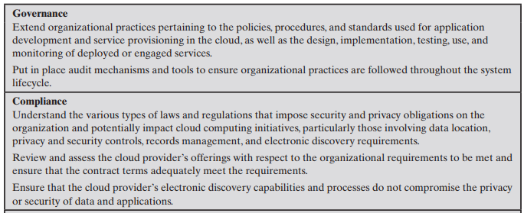
Electronic discovery, is the process of identifying, preserving, collecting, analyzing, and producing electronic data as part of a legal or regulatory investigation or litigation.

Slide 5
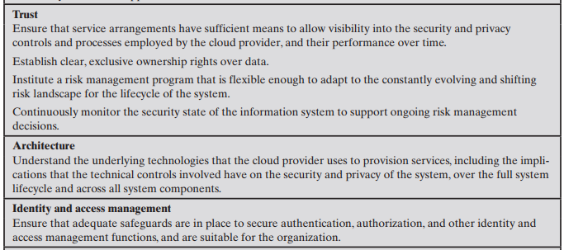
Risk management: the process of identifying, assessing, prioritizing, and mitigating risks associated with the use of cloud computing services.

Slide 6
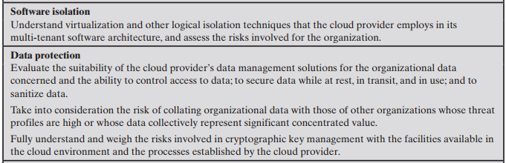

Slide 7
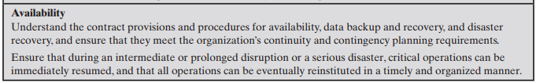
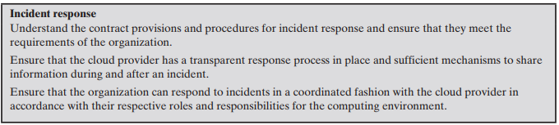

Slide 8
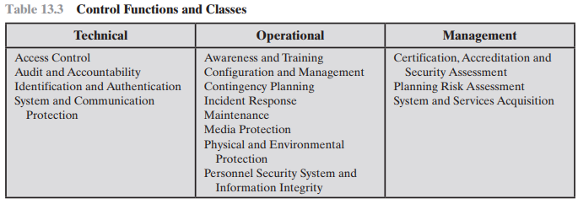

Slide 9
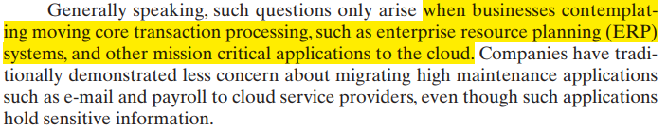
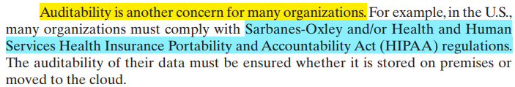

Slide 10
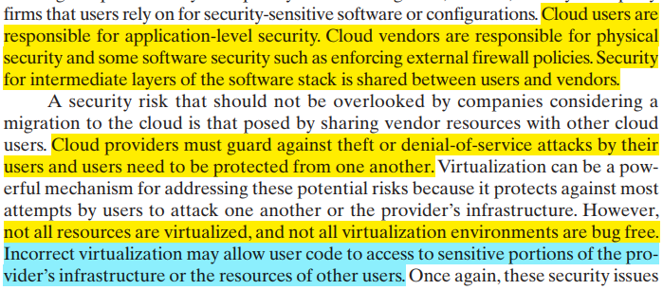

Slide 11
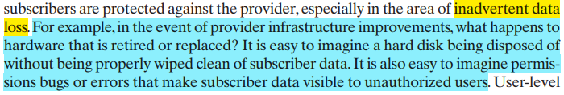

Slide 12

